Slide 1

Temporal Differences (TD) Algorithm
Benny Bornfeld

Slide 2

Background
MC methods suffer from two main drawbacks
Slow - Values are updated only after the episode is over. Episodes can be very long.
Bootstrapping is the process of updating value estimates based on other current value estimates. MC methods do not take advantage of the information stored in value estimates but rely only on updating using the actual reward.
Using Bootstrapping, TD methods allow immediate updates.

Slide 3
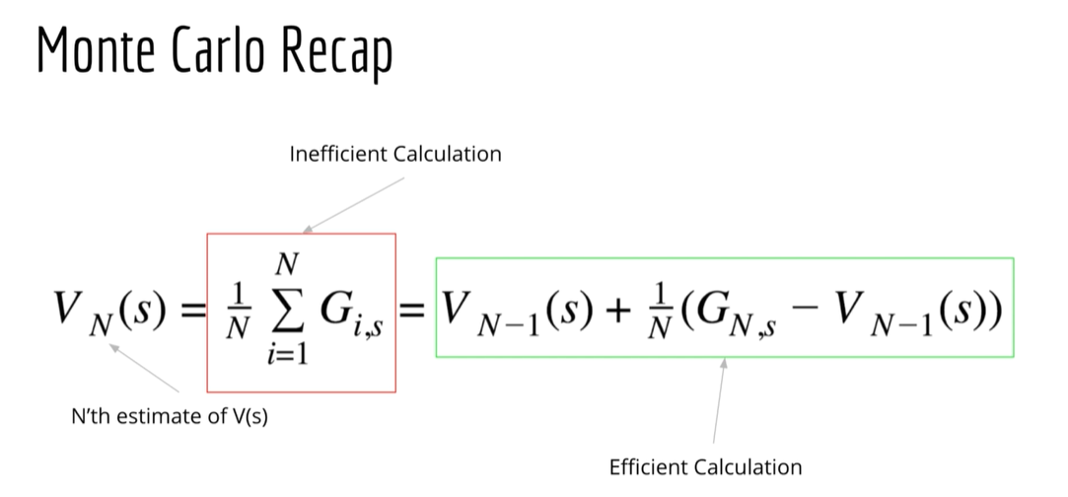

Slide 4
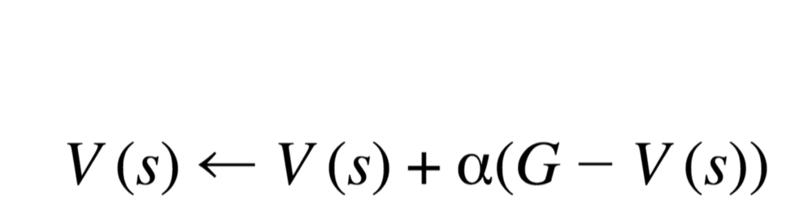
Rewriting MC with a fixed update value

Slide 5
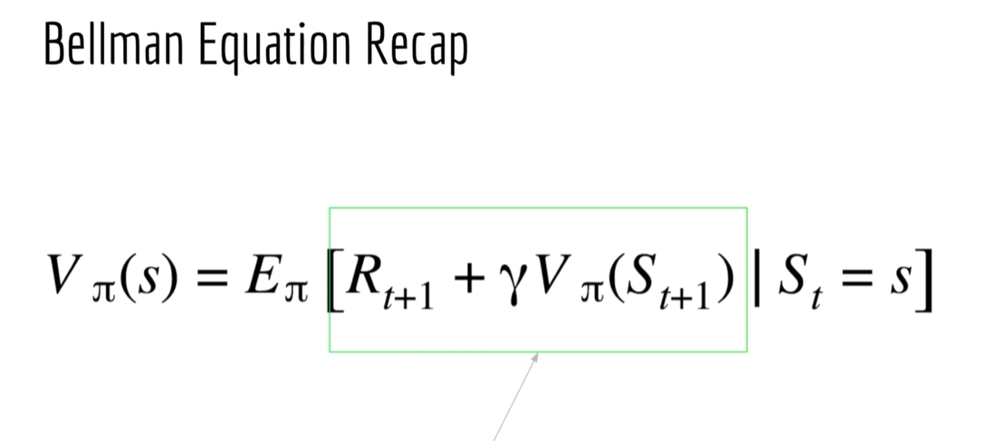

Slide 6
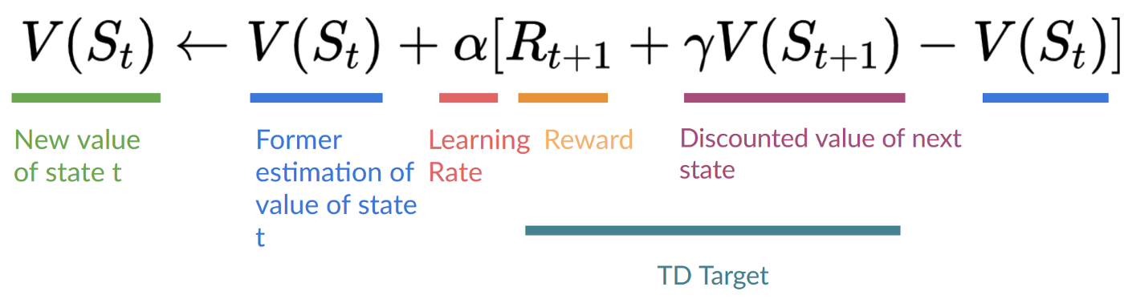
Temporal Differences (TD) Algorithms
Temporal Error

Slide 7
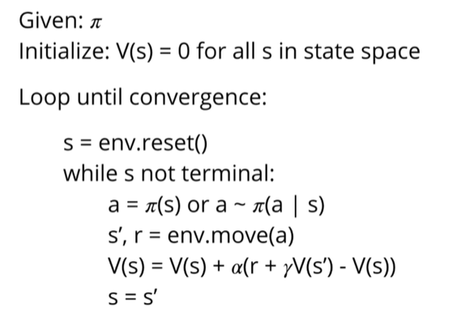
TD(0) – Policy Evaluation Algorithm

Slide 8

Policy Evaluation using TD0 example
=0.1
ϓ = 0.5
s3
s2
s1
R = +2
Episode 1 : S3->D->S6->R->S5->R->S4->U->S1
Episode 2: S3->D->S2->R->S1
s6
s5
s4
Episode 3: S3->D->S2->R->S5->R->S4->U-S1
s9
s8
s7

Slide 9
First episode
=0.1
ϓ = 0.5
S3->D->S6->R->S5->R->S4->U->S1
s3
s2
s1
R = +2
V3 = V3 + α (r + ϓ * V6 – V3) = 0
V3 = 0 + 0.1 (0 + 0.5 * 0 – 0) = 0
V6 = 0 + 0.1 (0 + 0.5 * 0 – 0) = 0
s6
s5
s4
0.2
V5 = 0 + 0.1 (0 + 0.5 * 0 – 0) = 0
V4 = 0 + 0.1 (2 + 0.5 * 0 – 0) = 0.2
s9
s8
s7

Slide 10
Second episode
=0.1
ϓ = 0.5
S3->D->S2->R->S1
s3
s2
0.2
s1
R = +2
V3 = 0 + 0.1 (0 + 0.5 * 0 – 0) = 0
V2 = 0 + 0.1 (2 + 0.5 * 0 – 0) = 0.2
s6
s5
s4
0.2
s9
s8
s7

Slide 11
Third episode
=0.1
ϓ = 0.5
s3
0.01
s2
0.18
s1
R = +2
S3->D->S2->R->S5->R->S4->U-S1
V3 = 0 + 0.1 (0 + 0.5 * 0.2 – 0) = 0.01
V2 = 0.2 + 0.1 (0 + 0.5 * 0 – 0.2) = 0.18
s6
s5
0.01
s4
0.38
V5 = 0 + 0.1 (0 + 0.5 * 0.2 – 0) = 0.01
V4 = 0.2 + 0.1 (2 + 0.5 * 0 – 0.2) = 0.38
s9
s8
s7

Slide 12
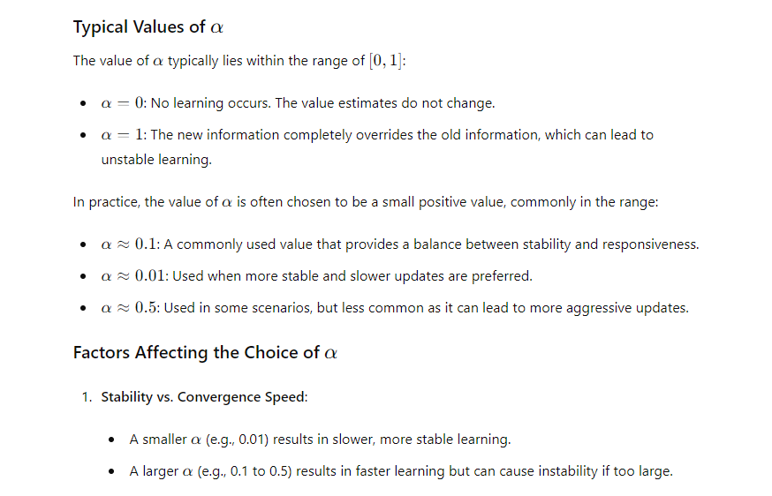
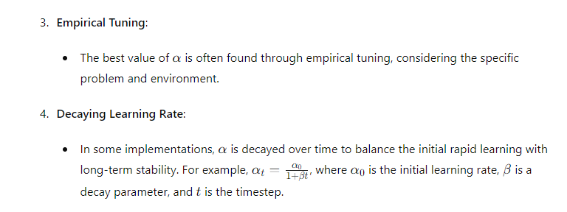
What is the optimal alpha size?

Slide 13

Class EX - Policy Evaluation using TD0 example
=0.2
s3
s2
s1
R = +2
ϓ = 0.5
Episode 1 : S6->R->S5->R->S4
s6
s5
s4
R = -4
Episode 2: S6->R->S5->R->S2->R->S1
Episode 3: S6->R->S5->R->S2->R->S5->R->S4
s9
s8
s7

Slide 14



TD-N
$$G(t)=\sum_{t=0}^{∞}{γ^{t}}⋅r_{t+1}$$
$$G(t)=r_{t+1}+γ^{1}r_{t+2}+γ^{1}r_{t+3}^{}+…+γ_{r_{n+1}}^{n}$$
V(t) = $r_{t+1}$ +$γ$* V(t+1)
G(t+1)
$$G(t)=r_{t+1}+γ^{1}r_{t+2}+γ^{2}r_{t+3}^{}+…+γ_{r_{n+1}}^{n}$$
V$(t)=r_{t+1}+γ^{1}r_{t+2}+γ^{2}\text{V}\text{(}\text{t}\text{+}\text{2}\text{)}$
G(t+2)

Slide 15

TD(1)
Temporal Error
$$r_{t+1}+γ^{1}r_{t+2}+γ^{2}\text{V}\text{(}\text{t}\text{+}\text{2}\text{)}$$

Slide 16

Take home message
Temporal Difference Method are model free
They combine the Monte Carlo method with estimating the return using the Bellman equation.
This allows them to bootstrap and update in every step, thus making them faster than MC.
The estimation can be of one step ahead (TD(0)) or n steps ahead (TD(n)).
There is a method called TDλ which combines several TD .

